Slide 1
Content Objective: Students will begin researching a modern A.I. moral dilemma in preparation for exhibition.
Monday Dec 16th
Continue A.I. Moral Dilemma
Discover the Good, Neutral, Evil components of your dilemma
What is the problem? What is your preferred solution?
Homework
No homework in the course. But I will make you think!

Slide 2
A.I. Moral / Ethical Dilemma
Choose a topic to research...
Uygur Muslim Humanitarian Crisis in China / Facial Recognition
Autonomous Weapons
Autonomous Cars
China’s “Social Credit” System (Coming to America?)
Deep Fakes / New Age Propaganda
A.I. Relationships (friendship, relationship, companionship, assistant)
A.I. Racial Bias in Court Decisions
A.I. Replacing Jobs / Universal Basic Income
Using A.I. Drones on the Border Instead of Building Wall
A.I. Teaching and Online Learning
Other?

Slide 3


Data Representation / Reasoning
What were the problems with how the AI program “PerfectMatch” paired pet buyers with a pet?
We took “training data” that included the 17 students in our classroom. The AI has discovered that people with an Asian ethnicity love Pomeranians! What was the issue with this?

Slide 4
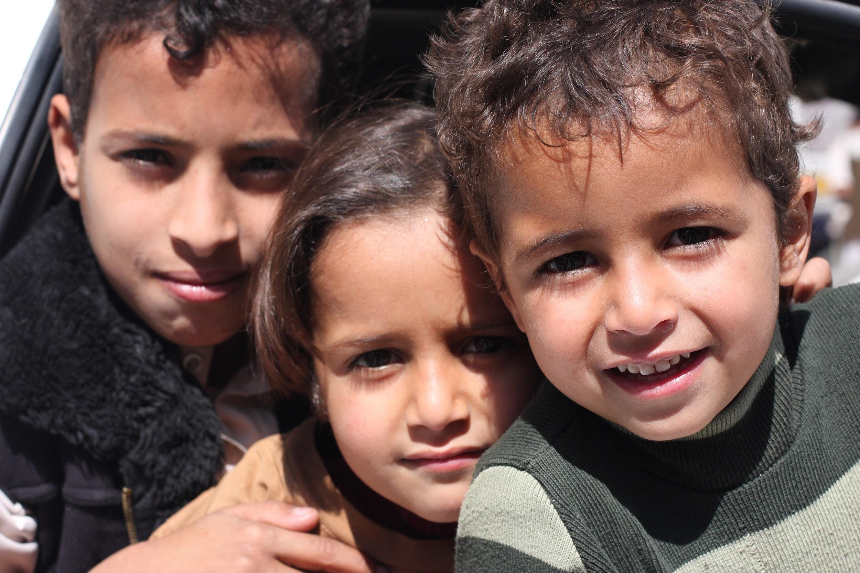
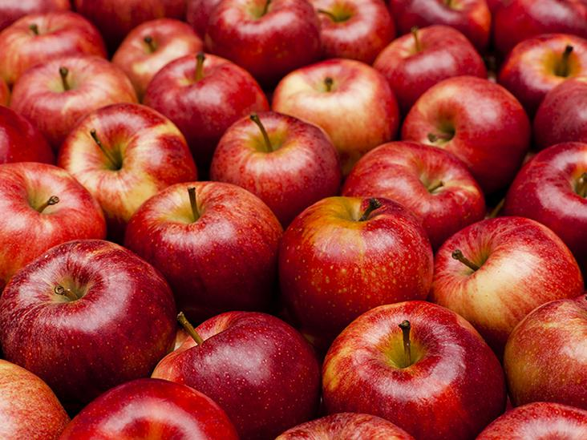
Data Interpretation
How many apples will 3 kids get if you have 12?

Slide 5
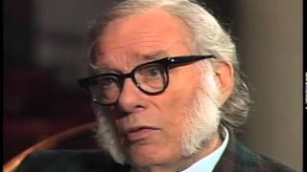
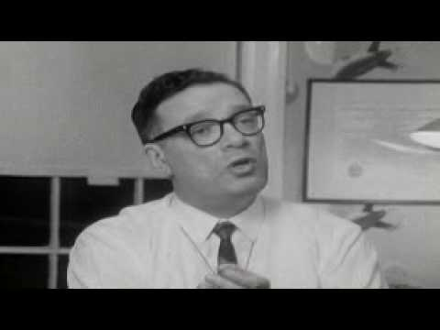
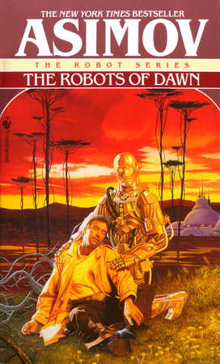
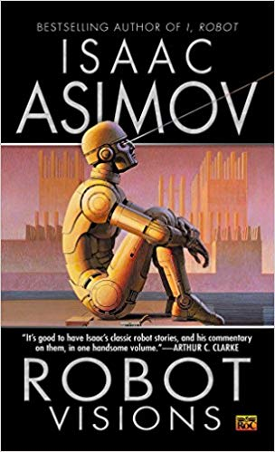
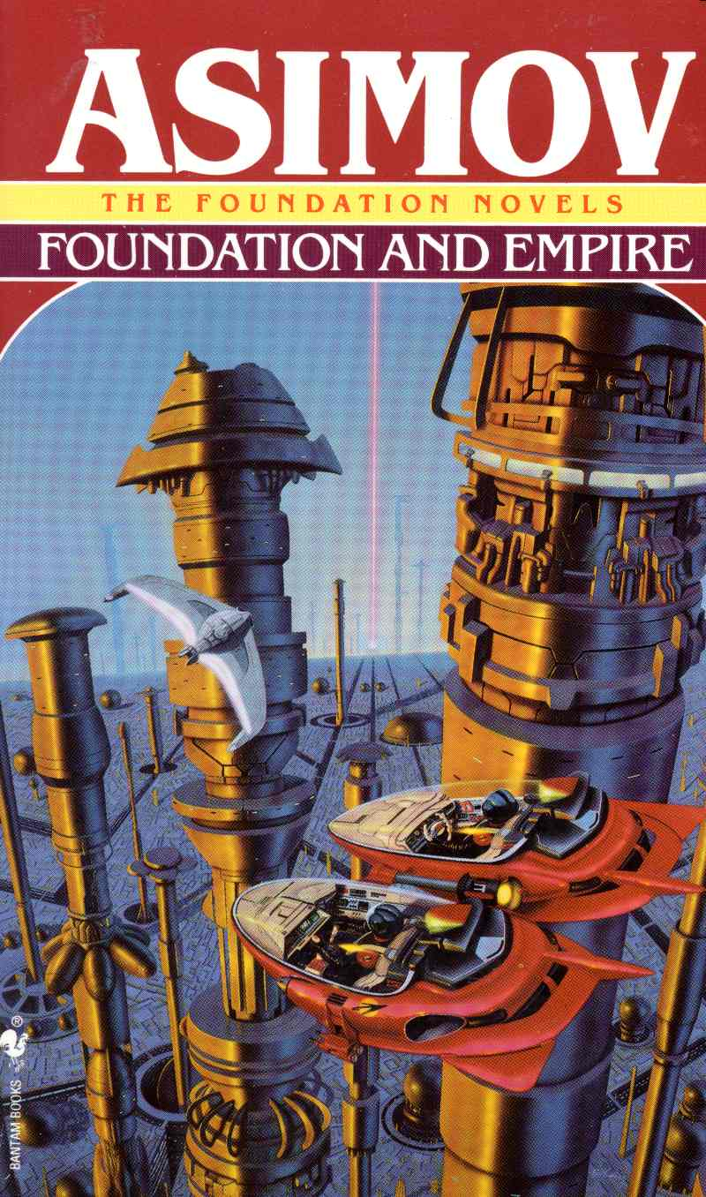
Natural Interactions With AI
(aka Robotics)

Slide 6
Isaac Asimov’s Three Laws of Robotics
A robot may not injure a human being or, through inaction, allow a human being to come to harm.
A robot must obey orders given it by human beings except where such orders would conflict with the First Law.
A robot must protect its own existence as long as such protection does not conflict with the First or Second Law.
What do you think of these “laws?”
Can you think of scenarios for a robot / human that may break or dismantle these laws?

Slide 7
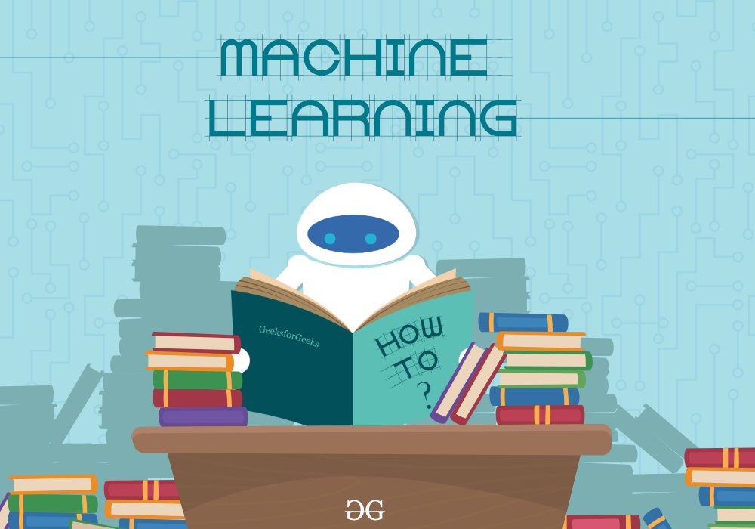
Machine Learning
Go to this website -
https://teachablemachine.withgoogle.com

Slide 8
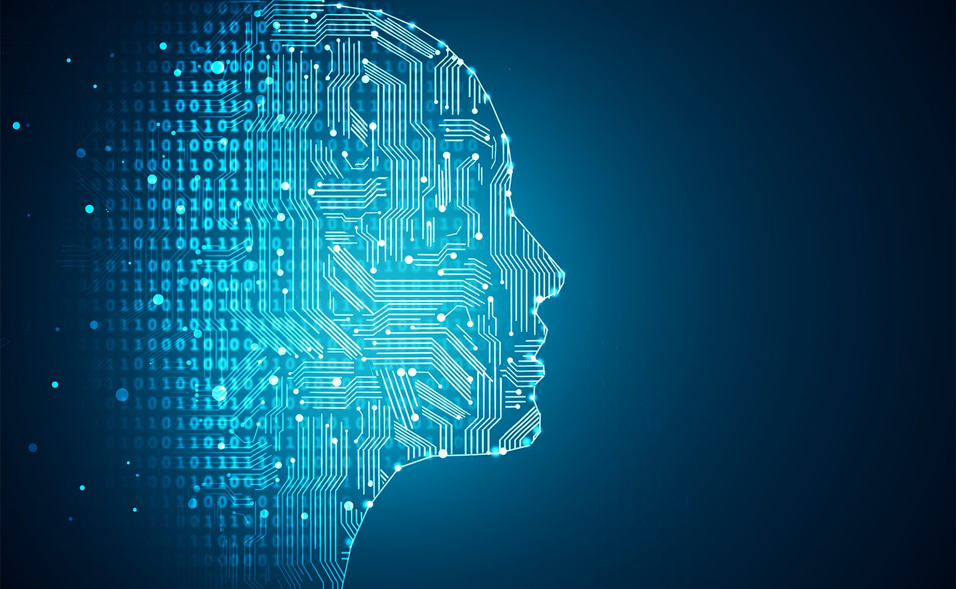
Machine Learning Levels
Pick one to teach the class....
Narrow Intelligence
General Intelligence
Super Intelligence

Slide 9
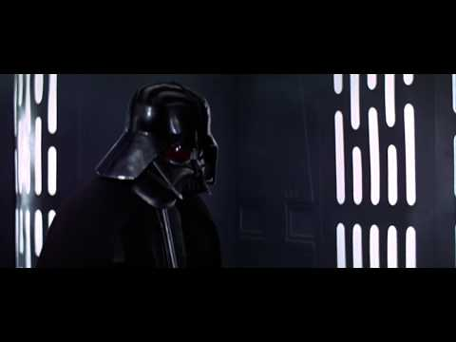
Ethics of Machine Learning
The “Student - Master” Dilemma

Slide 10
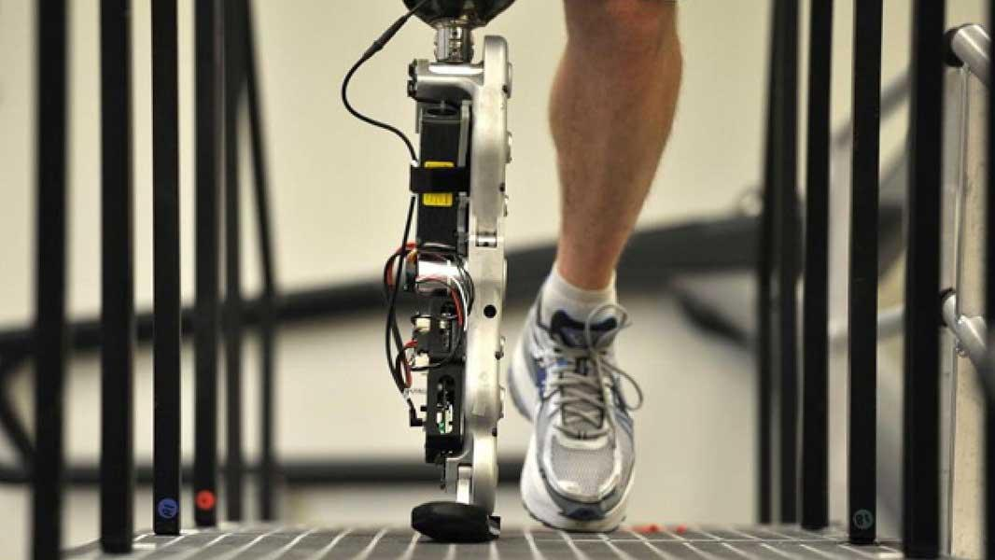
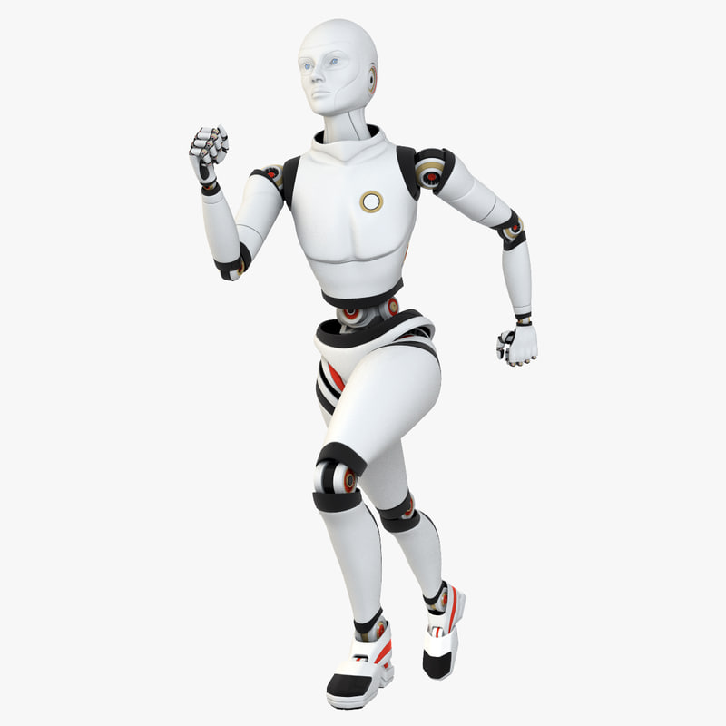
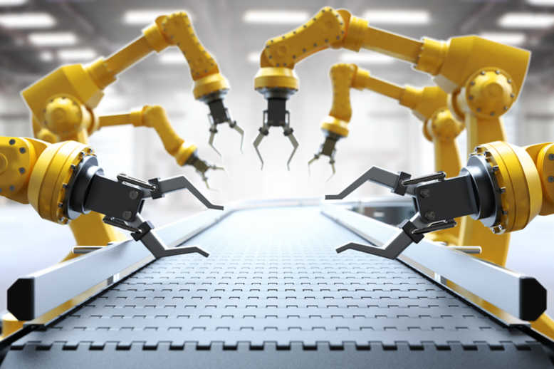
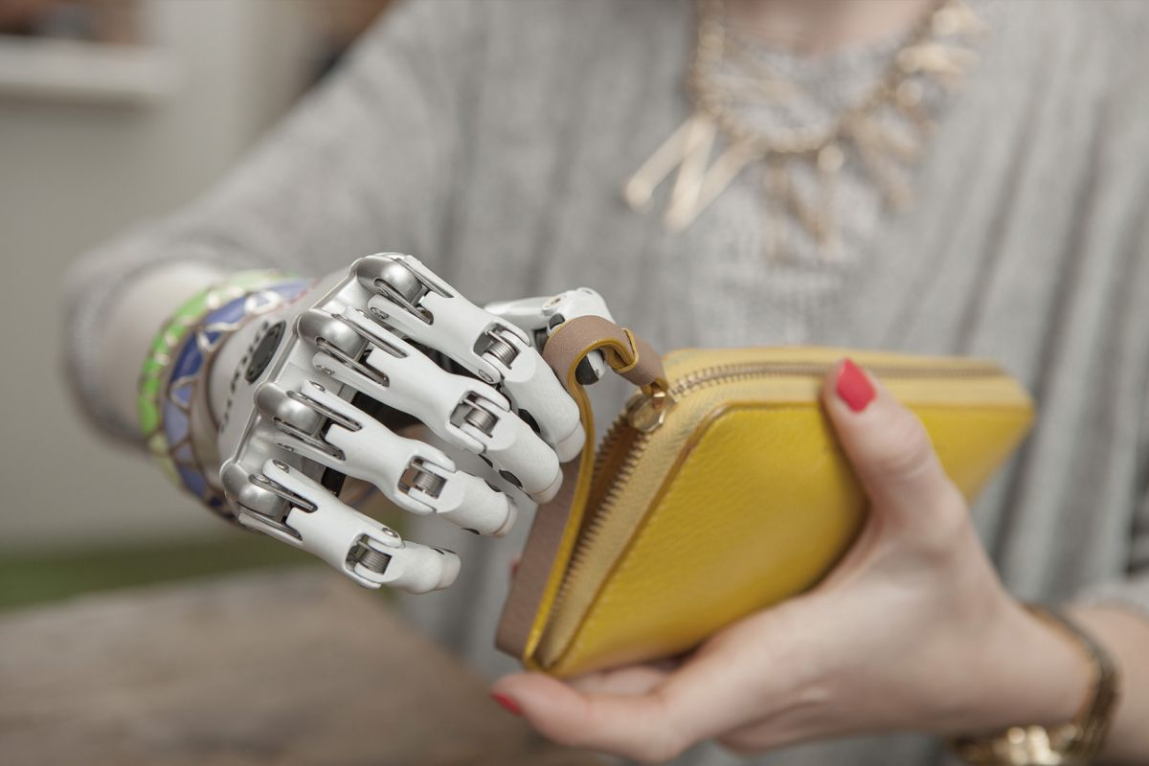
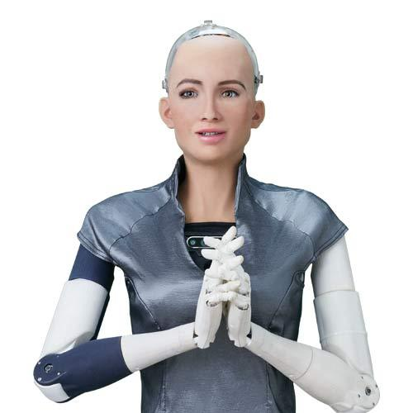
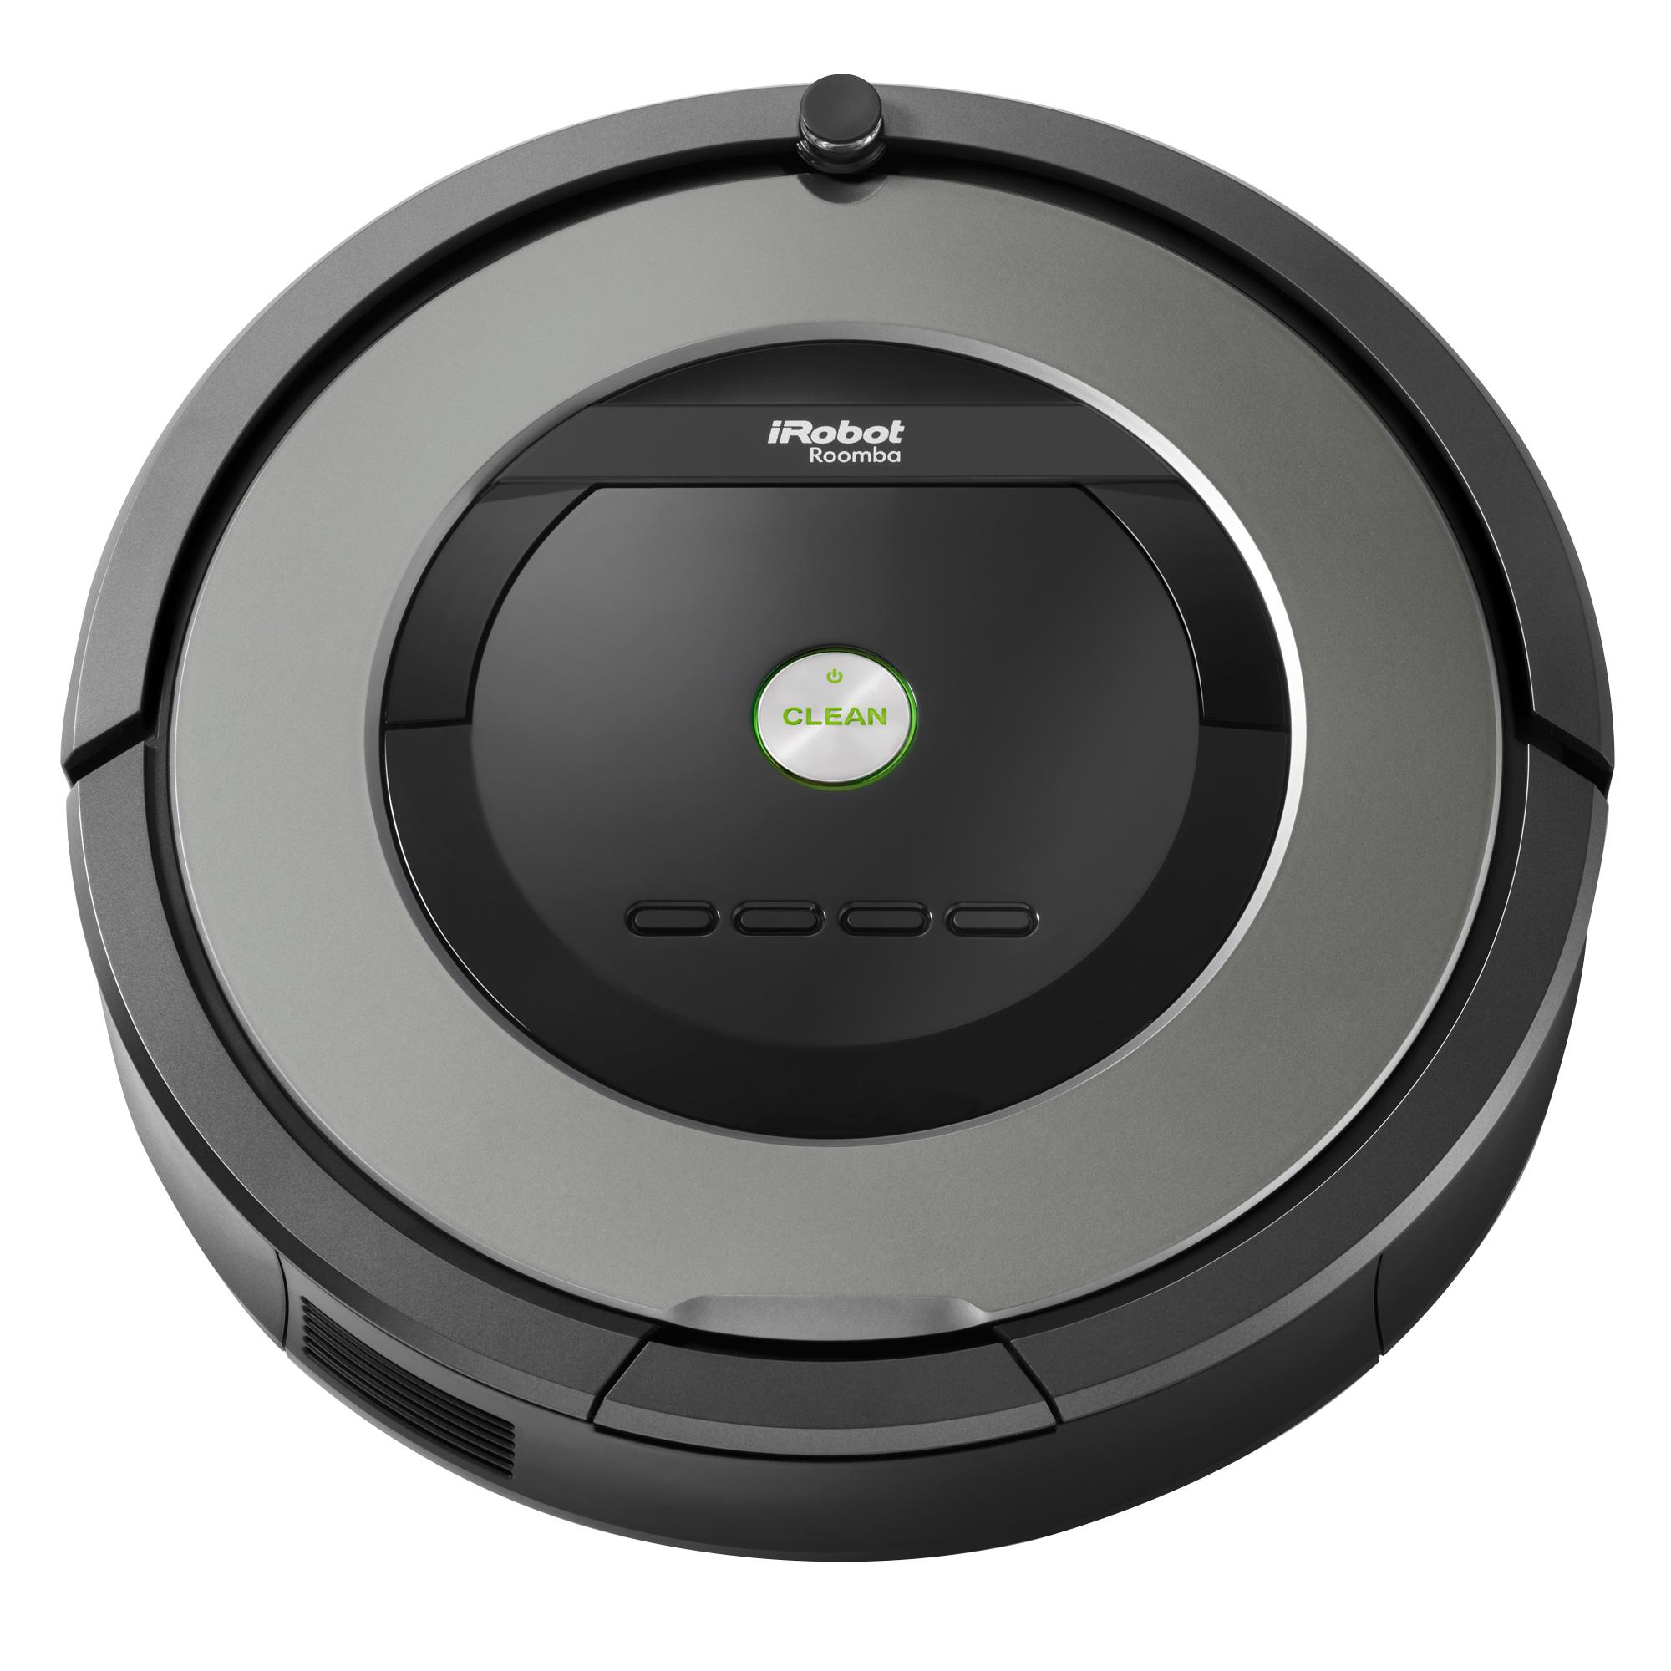
Cyborgs / Androids / Robots
What’s the Difference? Uses for each?

Slide 11
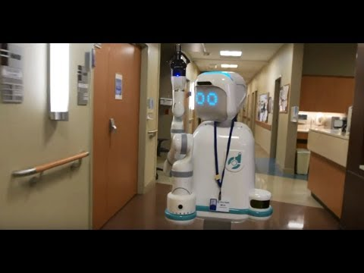
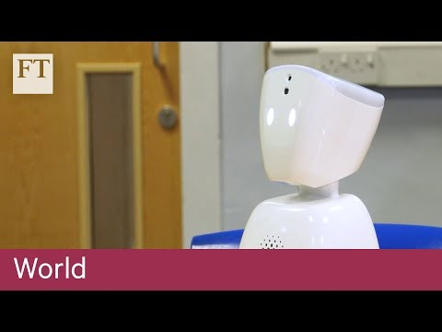
Natural Interaction
Hospitals
Schools

Slide 12
Ethics of Natural Interaction / Future Prospects
Let’s go back to your ethical code. Consider all of the things we have talked about in our presentations and in this course.
Place new scenarios and future AI possibilities on your ethical list.
Do you notice a pattern of where you are placing these things? Does it skew evil? Good? Perhaps this is why it is important that we discuss and learn about this!
“Evil” “Neutral” “Good”

